Slide 1



Invoke-NoShell
All the Power with no Shell
@Gal_B1t

Slide 2





WHOAMI
Threat intel
Dev
Full-stack researcher
Open-source projects
https://github.com/G4LB1T

Slide 3
Outline
PoWERSH^eLL:
Blue & Red team +/-
Invoke-NoShell: From $NULL to hero in one click
Test-drive results

Slide 4

Blue Team’s PoV

Slide 5
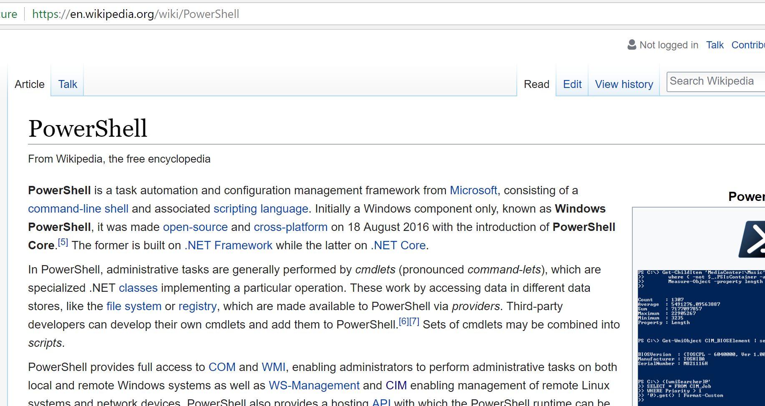

Slide 6
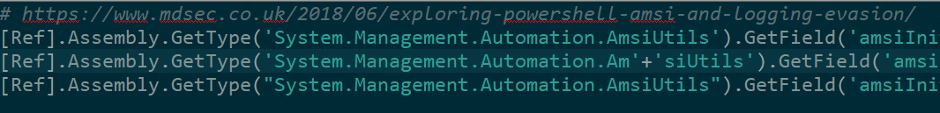
Why PowerShell?
Easy to learn & use
.NET power
Compatible with many IT frameworks
WMI
COM
Better security nowadays (logging, AMSI)

Slide 7
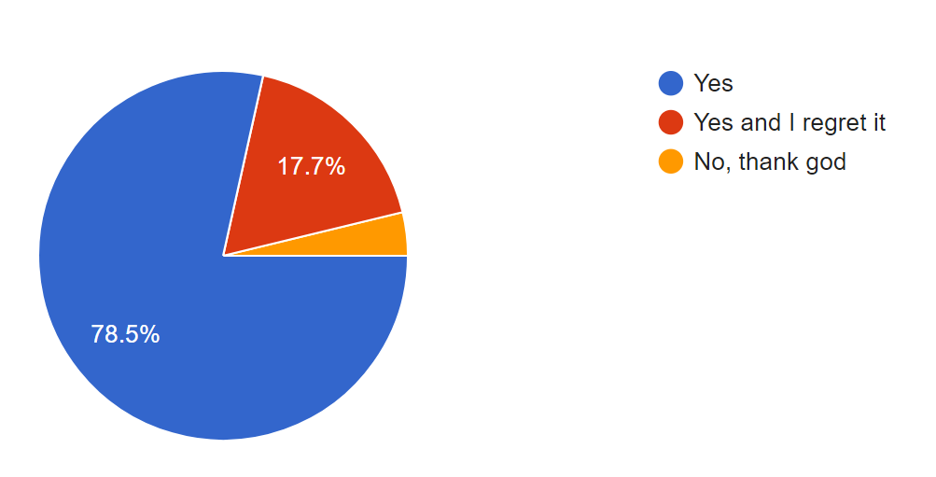
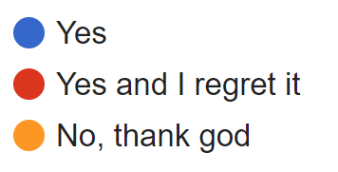
Have you ever used PowerShell?
That’s me :(
97% used PowerShell

Slide 8

Red Team’s PoV

Slide 10
Why PowerShell?
Easy to learn & use
.NET Power
Compatible with many IT frameworks
WMI
COM
File-less

Slide 11
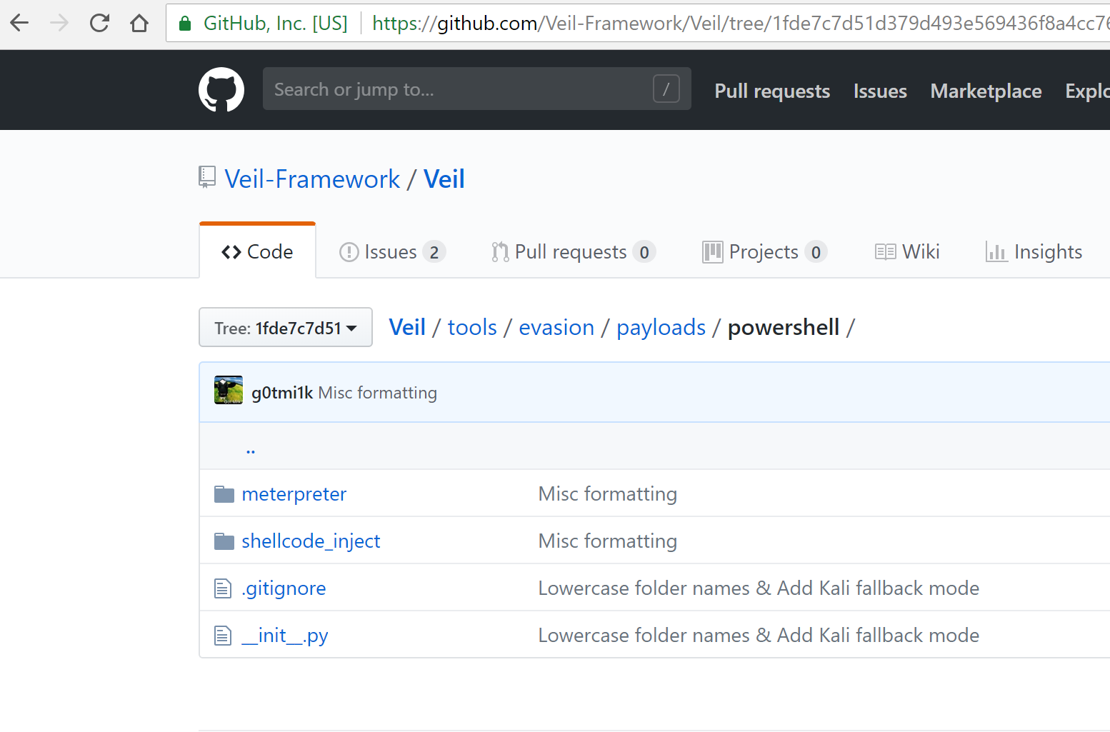

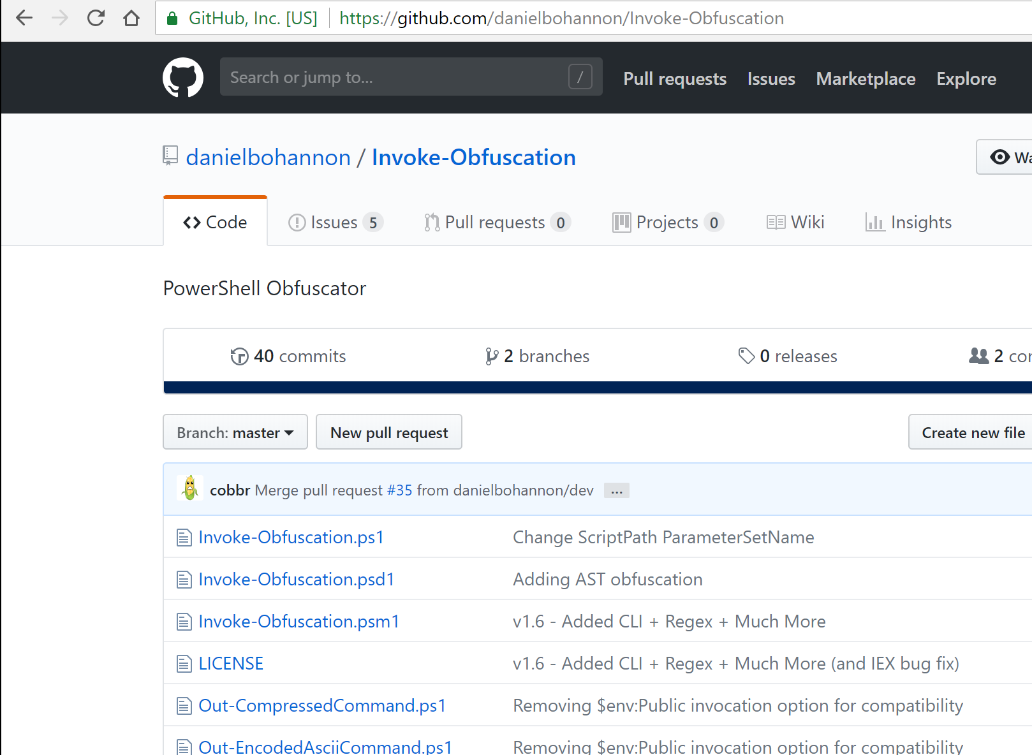
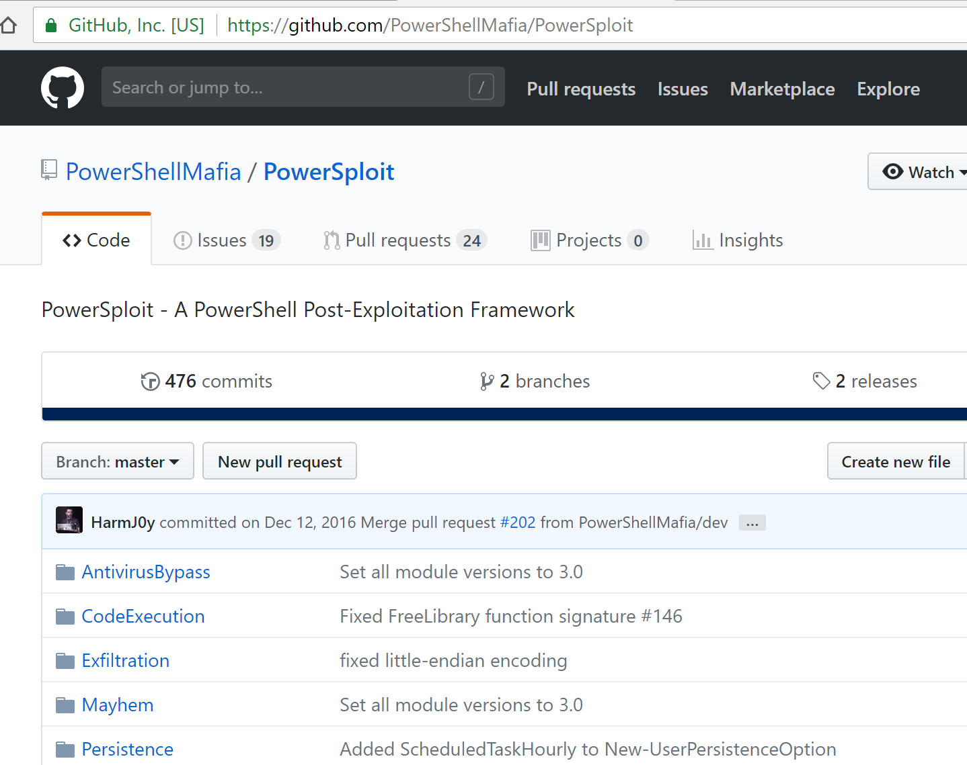
Why PowerShell? (contd.)
Existing work
PowerShell Mafia
Invoke-Obfuscation
~Veil, Metasploit
Gazilion other ones…

Slide 12
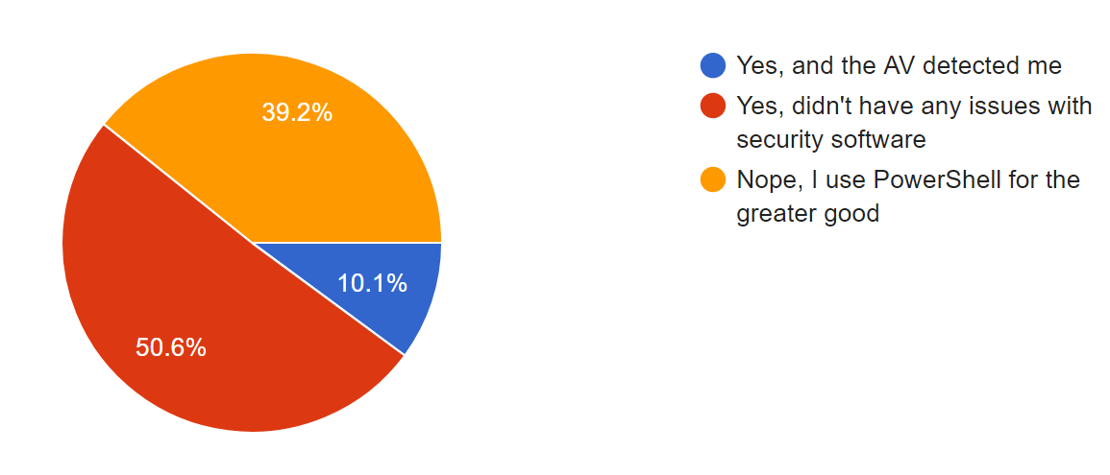
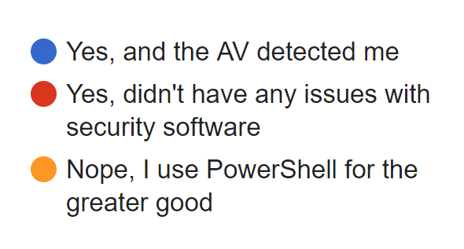
Have you ever used PowerShell to deploy malicious code?
83% of the malicious users bypass the AV
Notes:
(for educational purposes, of course)

Slide 13
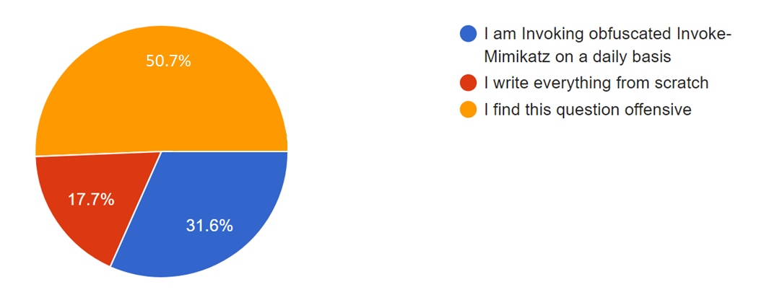
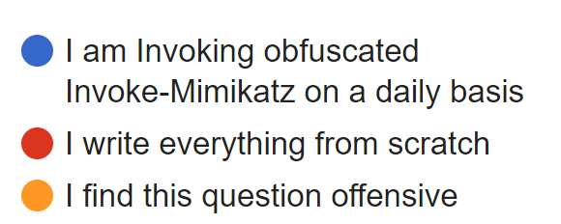
Have you ever used offensive PowerShell frameworks?
60% of the malicious users prefer frameworks

Slide 14
But not everything is so color d0…

Slide 15
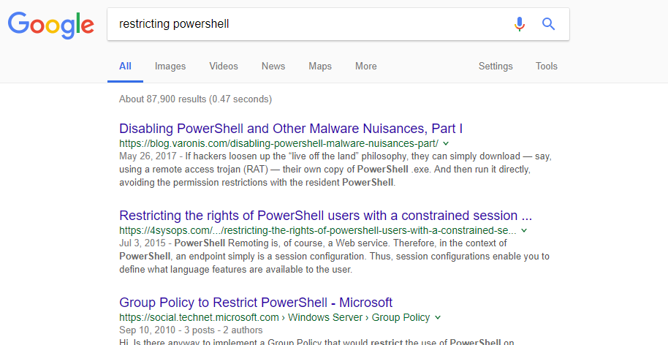

Slide 16
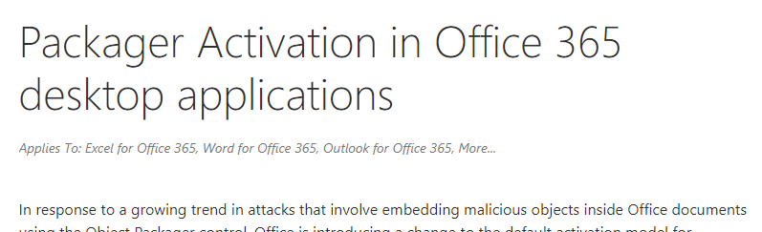
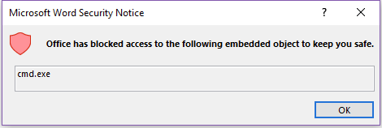

Slide 17
Malware Evolution
Initial version
OnOpen
OnClose
OnClick
ep bypass
Final version
Don’t bypass

Slide 18
Malware Evolution
Initial version
OnOpen
OnClick
Add feature E
Add feature F
OnClose
Add feature G

Slide 19
Malware Evolution
Initial version
OnOpen
OnClose
OnClick
ep bypass
Final version
Don’t bypass

Slide 20
Malware Evolution
Initial version
OnOpen
OnClose
OnClick
ep bypass
Final version
Don’t bypass

Slide 21
Malware Evolution
Initial version
OnOpen
OnClick
ep bypass
Don’t bypass
OnClose
Final version

Slide 22

https://github.com/curi0usJack/luckystrike

Slide 23

What are red teamers missing?
Overcoming restrictions – effectively!
Weaponizing multiple variants

Slide 24
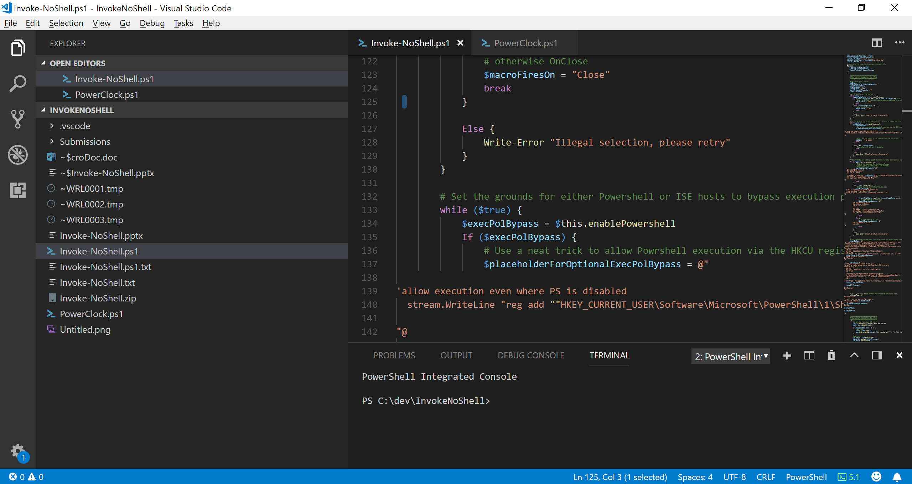
Invoke-NoShell
https://github.com/G4LB1T/Invoke-NoShell

Slide 25
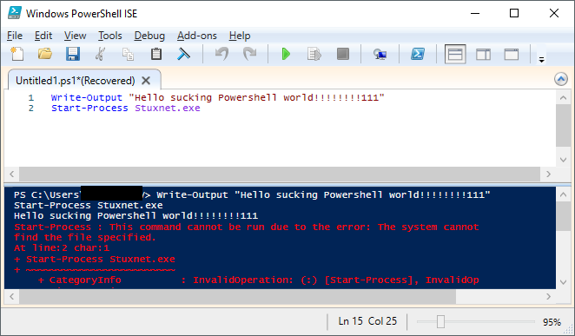

Slide 26
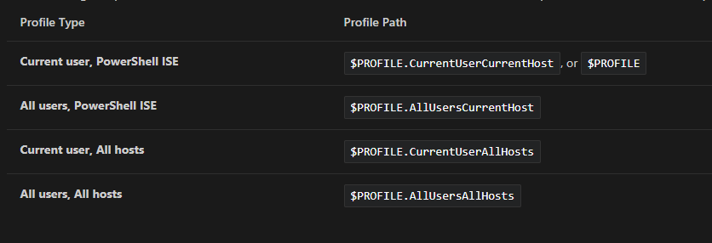

https://docs.microsoft.com/en-us/powershell/scripting/core-powershell/ise/how-to-use-profiles-in-windows-powershell-ise

Slide 27
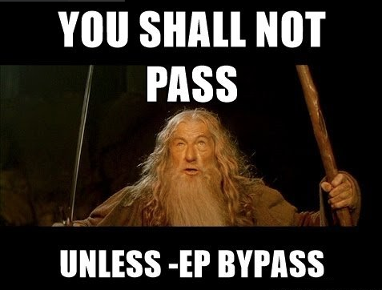
But wait! You can’t -ep bypass!

Slide 28
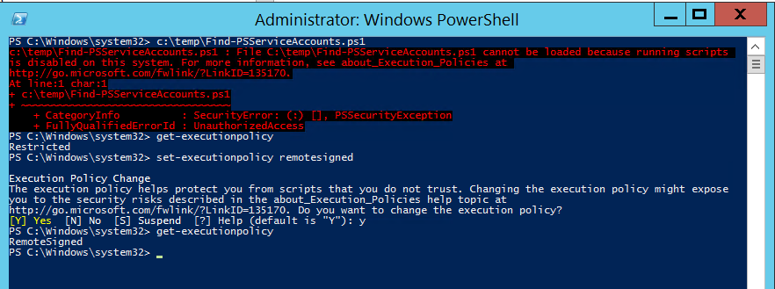
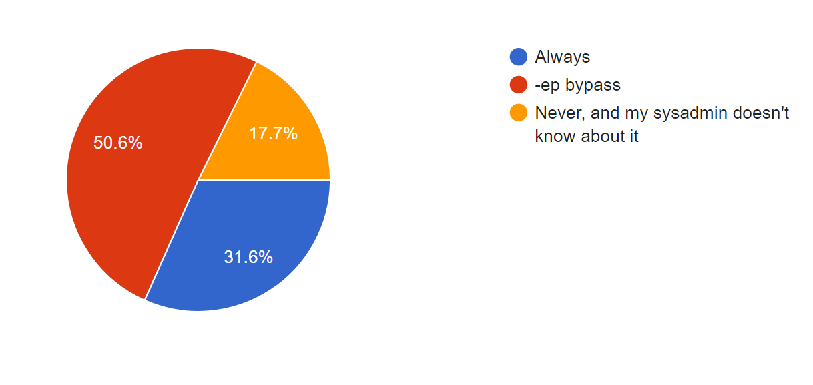
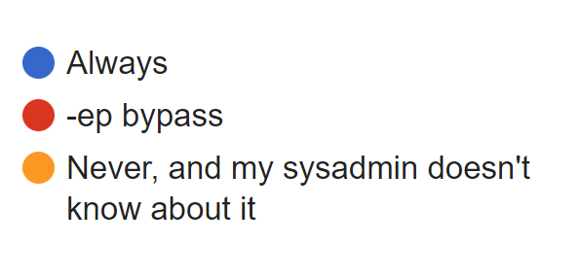
How often do you encounter the "powershell execution is disabled on this system" message?
30% of users always see this annoying message

Slide 29
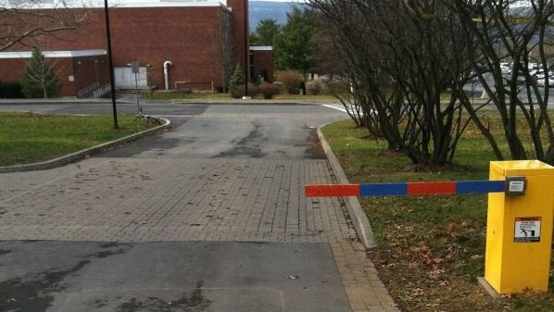
Execution Policy restriction does not work !!!

Slide 30
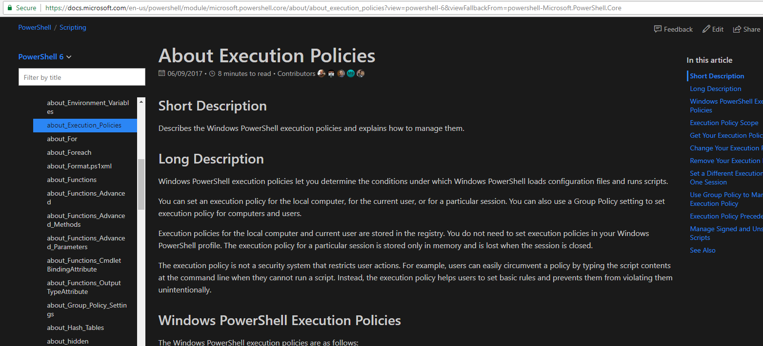
The execution policy is not a security system that restricts user actions. For example, users can easily circumvent a policy by typing the script contents at the command line when they cannot run a script. Instead, the execution policy helps users to set basic rules and prevents them from violating them unintentionally.

Slide 31
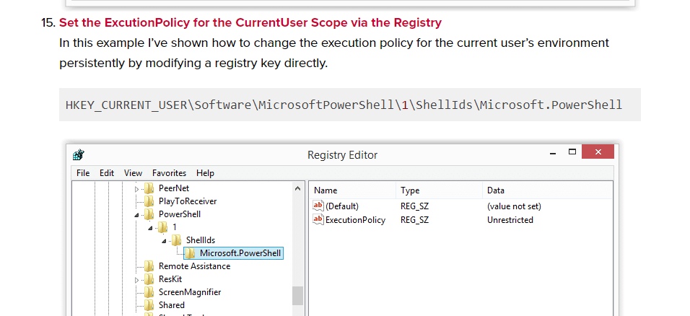
https://blog.netspi.com/15-ways-to-bypass-the-powershell-execution-policy/

Slide 32
Malware Instance | Vendor A | Vendor B | Vendor C | Vendor D | Vendor E | Vendor F
Combination A | Detected
Combination B | Bypassed
Combination C
Combination D
Combination E
Combination F
Combination G

Slide 33
A couple of days later, loathing PowerShell more than ever…

Slide 34
Invoke-NoShell: how does it work?
Using PowerShell to create more PowerShell (and VBA) ☺
Office COM object (you need to have Office ☹)
Launch on:
Open
Close
click
Host:
PowerShell
PowerShell ISE
Optional bypass for ExecutionPolicy (via registry key)
Bonus – SettingContent OLE!

Slide 35
Manual mode
Select features
Document is ready!
Auto mode
Document is ready!
13 different combinations
Document is ready!
Document is ready!
Document is ready!
Document is ready!
Document is ready!

Slide 36
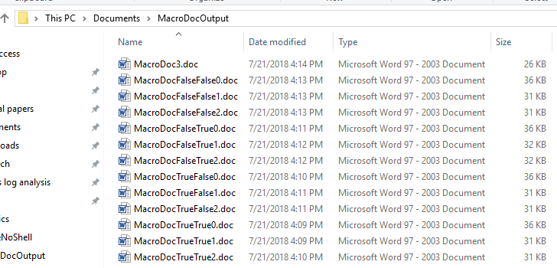

Slide 37
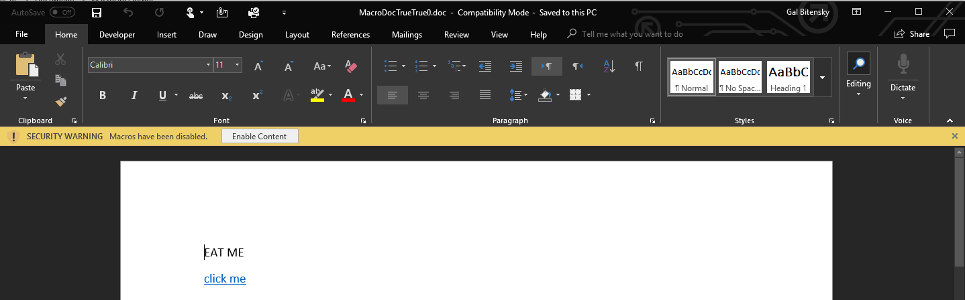

Slide 38
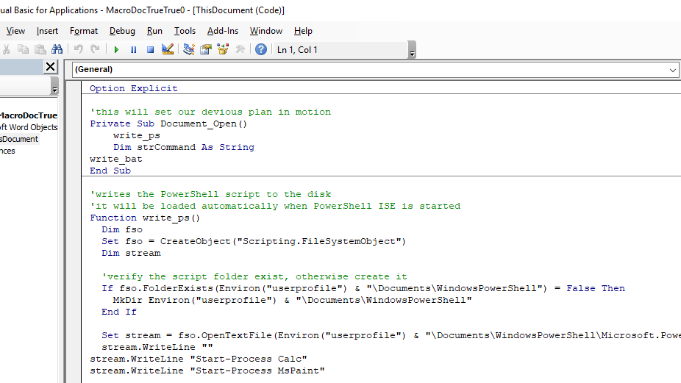

Slide 39

The Test

Slide 40
The Payload
Standard generic malware
Invoke-ReflectiveInjection
All local, no base64
13 documents

Slide 41
The Victim
Windows 10 x64
5 popular enterprise AV software (including “NG”)
Fully enabled

Slide 42

Great Success?

Slide 43

100%

Slide 44
Takeaways
Work in scale, effectively
Adopt new techniques fast

Slide 45
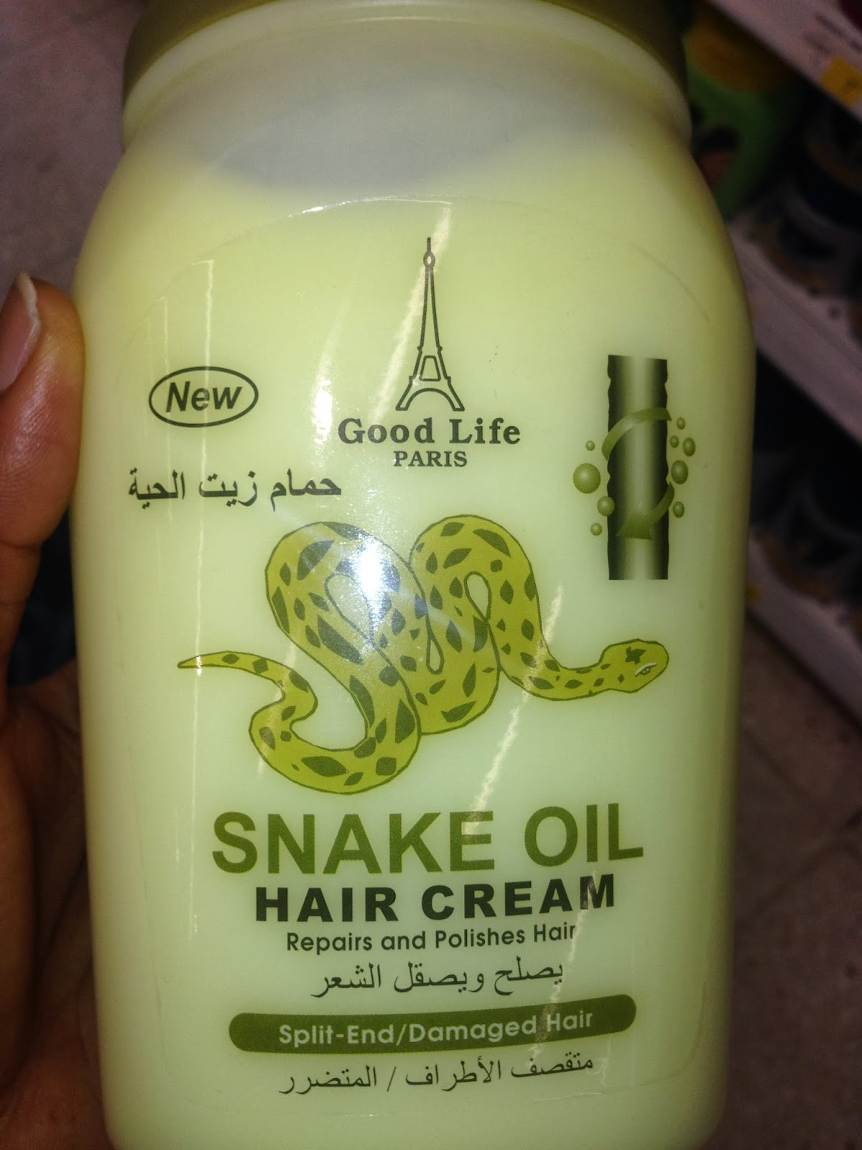

Takeaways
Test your own security, be skeptical about efficacy claims
Notes:
Bypassing AV is EZ
See 4 yourself

Slide 46



TODOs + Q&A
@Gal_B1t
https://github.com/G4LB1T

